Slide 1

DEPARTMENT OF COMPUTER SCIENCE,
GUJARAT UNIVERSITY
M.Sc AI & ML 2019-20
SEMESTER 1 PROJECT
Sentiment analysis using twitter data
PROJECT SUPERVISOR
PRESENTED BY
DR.JYOTI PAREEK
VATSAL GAMIT (09)
MOHIT TALREJA (32)

Slide 2
1.WHAT IS SENTIMENT ANALYSIS?
INDEX
2.WHY WE USE SENTIMENT ANALYSIS?
3.HOW TO MAKE SENTIMENT ANALYSIS?

Slide 3
1
WHAT IS SENTIMENT ANALYSIS ?

Slide 4
WHAT IS SENTIMENT ANALYSIS ?
“
“ Sentiment analysis is the practice of applying natural language processing and data analysis techniques to identify and extract subjective information from data.”

Slide 5

WHAT IS SENTIMENT ANALYSIS ?
The Process of Analyzing the data in form of text, to extract
relevant information like if an opinion is “Positive”, “Negative” or “Neutral” based on normal Humans conversation.
Opinion

Slide 6

WHAT IS SENTIMENT ANALYSIS ?
This is also called opinion mining because it includes different identifying attributes , emotions, and opinion about the various topics.
During process it gives the value to a word to determine the word’s positivity or negativity.
It’s a powerful tool to create trends or to influence the target audience

Slide 7
2
WHY SENTIMENT ANALYSIS ?

Slide 8
WHY SENTIMENT ANALYSIS ?
It helps different sectors by monitoring the sentiments of people about their articles, products or their services.
Also most of the internet data in textual form which easily can be analysed.
Some real life applications
Social Media Marketing
Brand Monitoring
Trend Making
Customer Services
Market Research
Security Analysis
Prediction Making

Slide 9


WHY WE CHOOSE TWITTER ?
• Popular microblogging site users often discuss current affairs and share personal views on various subjects.
• Short Text Messages of 140 characters
• 240+ million active users and so no shortage of tweets for analysis

Slide 10
3
HOW TO DO SENTIMENT ANALYSIS ?

Slide 11
Process Flow
FETCHING TWEETS
SAVE
TWEETS
file.csv or file.text
TOKENIZATION
(stop words,lexicons)
INPUT
TWEEPY API
TWEET SENTIMENT
SENTIMENT ALGORITHM
FEATURE IDENTIFIER

Slide 12
Challenges
• People express opinions in complex ways
• In opinion texts, lexical content alone can be misleading
• Intra-textual and sub-sentential reversals,negation, topic change common
• Rhetorical devices/modes such as sarcasm, irony, implication, etc.
• Unstructured and also non-grammatical
• Lexical Variation
• Out of Vocabulary Words
• Extensive usage of acronyms like asap, lol, afaik

Slide 13
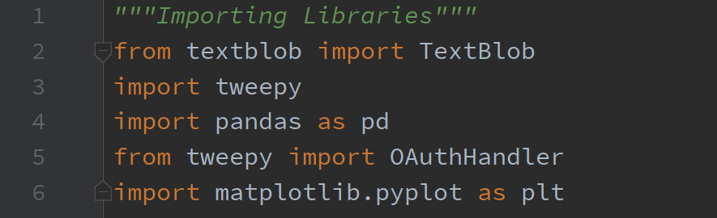
Required Libraries

Slide 14
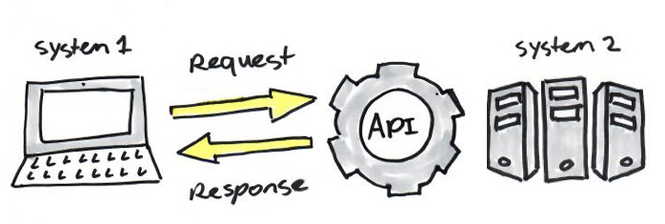
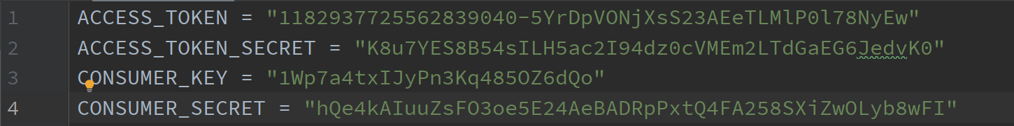
Step 1: Connecting to Stream
An API called Tweepy is used, which is also compatible with Python Language. Some credentials for Access Token keys and Consumer Secret Keys to use the developer account

Slide 15
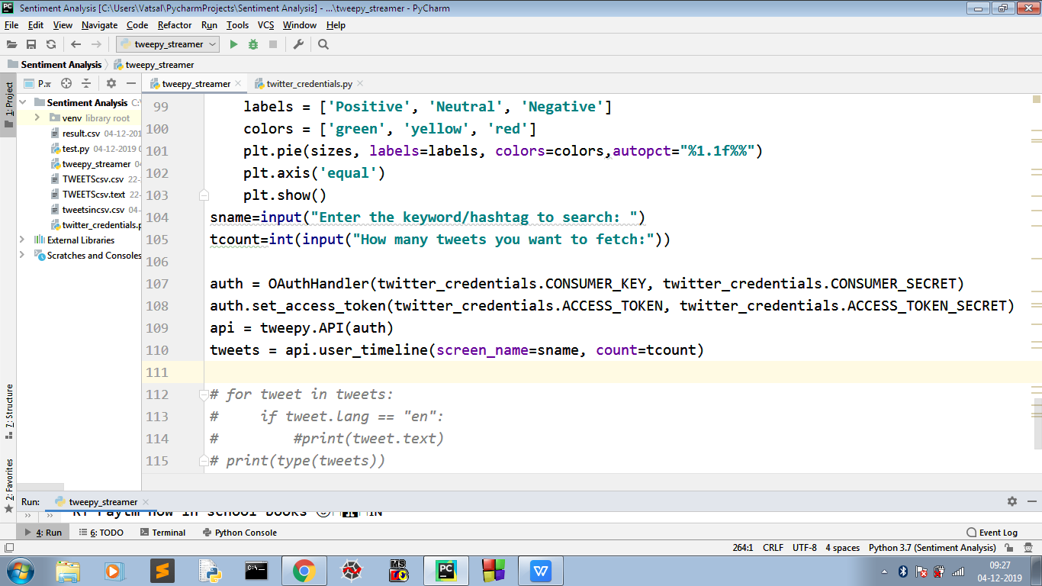
Step 2: Fetching Tweets

Slide 16
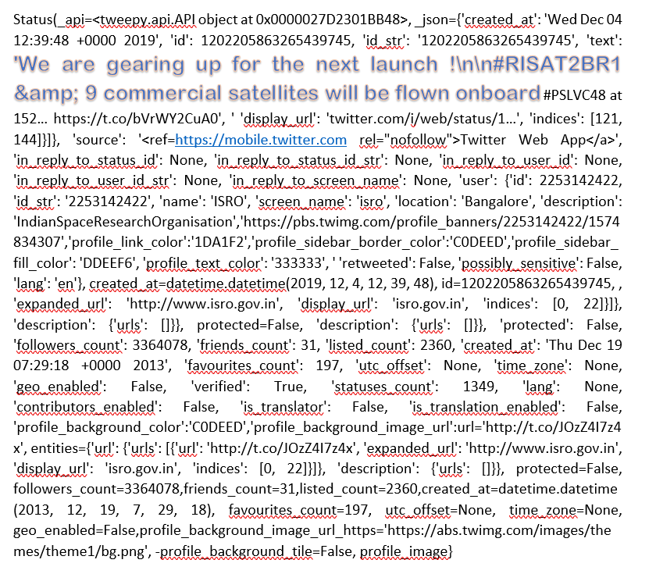
One whole tweet with meta deta

Slide 17
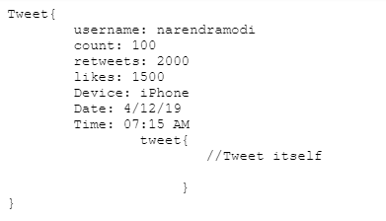
Usual JSON file format

Slide 18
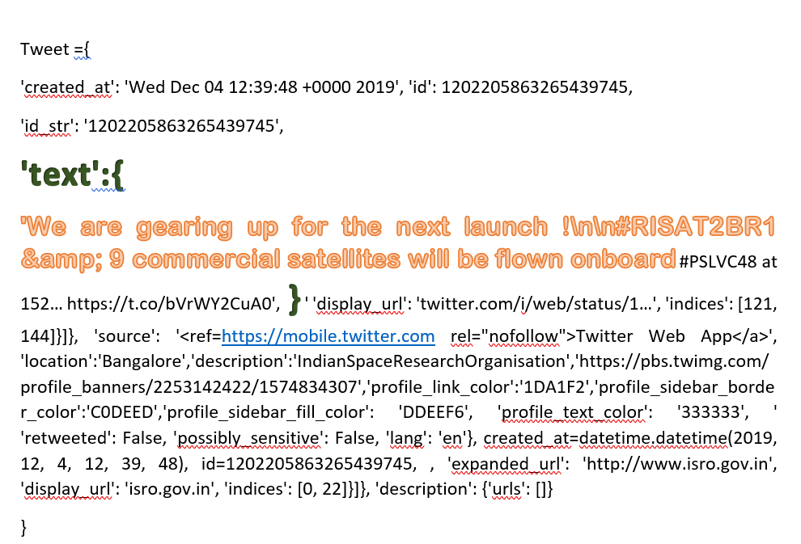
After removing most of unnecessary JSON objects

Slide 19
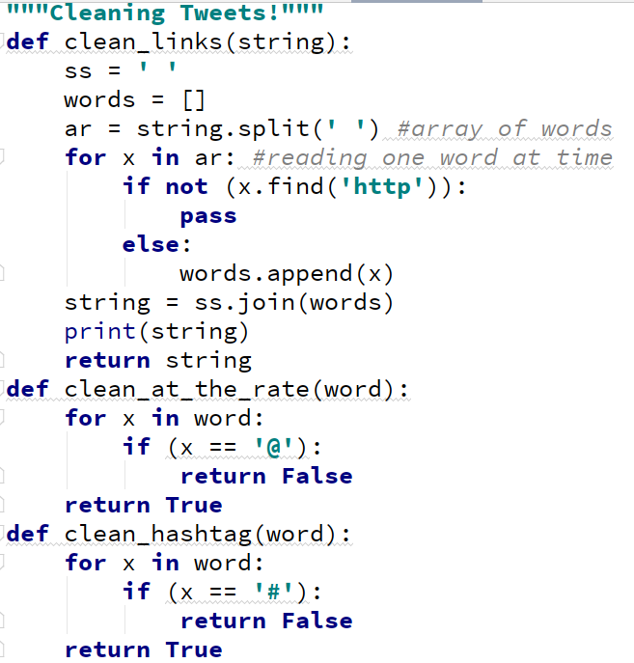
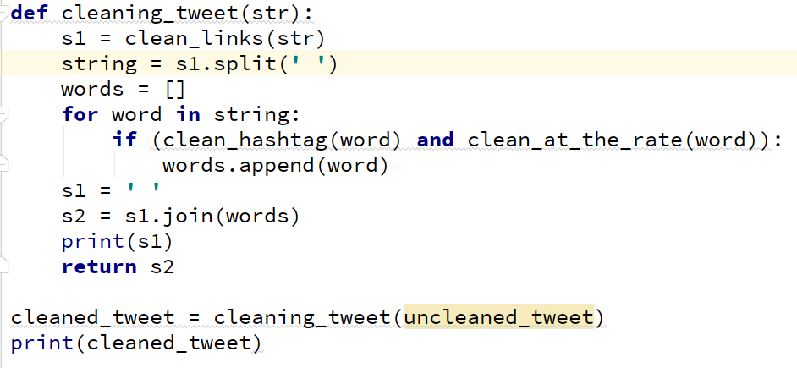
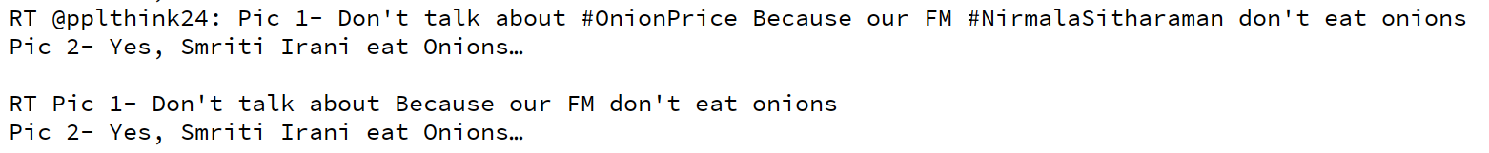
Cleaning Tweets
Cleaning Links
Cleaning ‘@’
Cleaning ‘#’

Slide 20
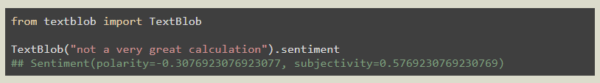
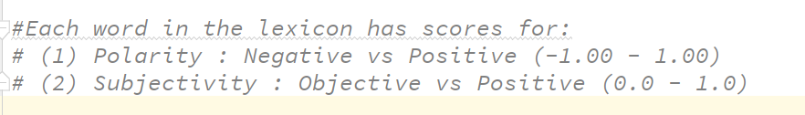
Step 3: Anyliasing Tweets
The TextBlob package for Python is a convenient way to do a lot of Natural Language Processing (NLP) tasks. For example:
TextBlob scores are based on words used.

Slide 21
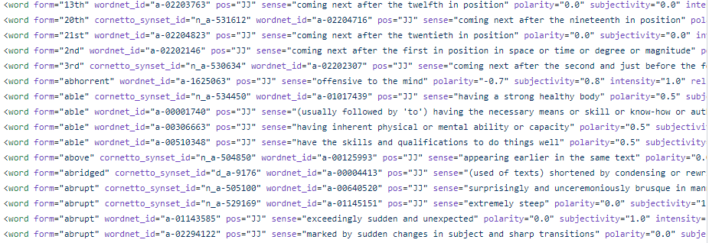
Lexicons
The lexicon it refers to is in en-sentiment.xml, an XML document that includes the following four entries for the word “great”.

Slide 22



Polarity/Subjectivity and Effect of Adjective
The lexicon it refers to is in en-sentiment.xml, an XML document that includes the following four entries for the word “great”.
Negation multiplies the polarity by -0.5, and doesn't affect subjectivity.
Addition of an ‘very’ as adjective

Slide 23
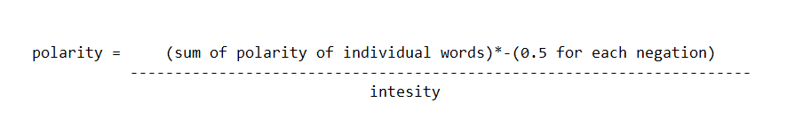
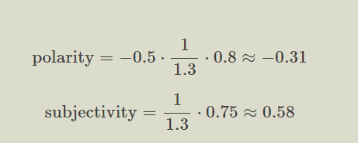
So overall sentiment of following sentence :
Sentence = “Not very great”
Formula to find Polarity

Slide 24
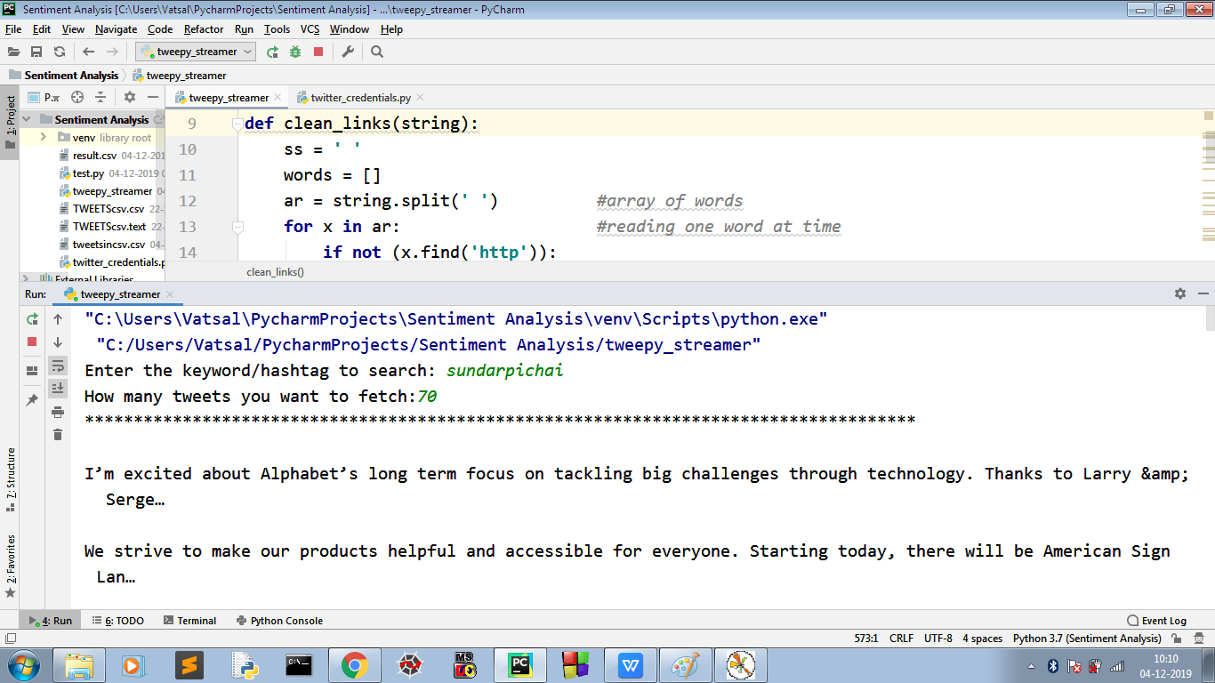
RESULT:

Slide 25
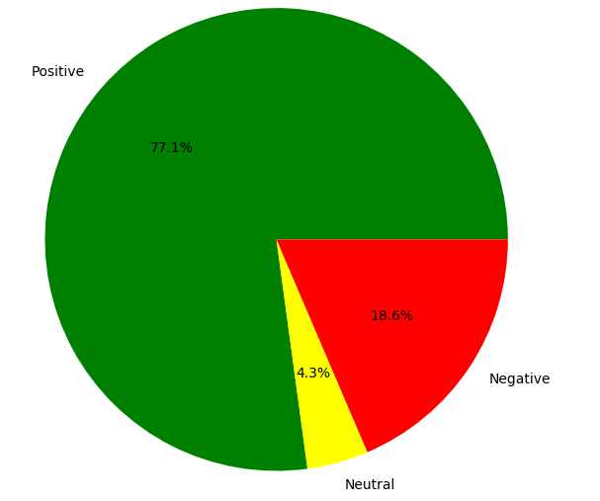
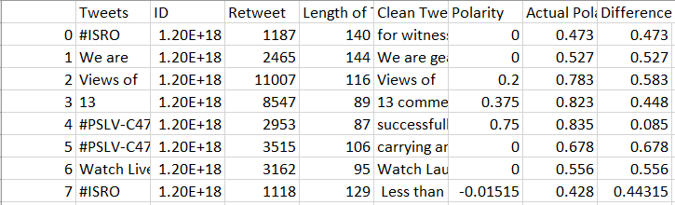
RESULT:

Slide 26

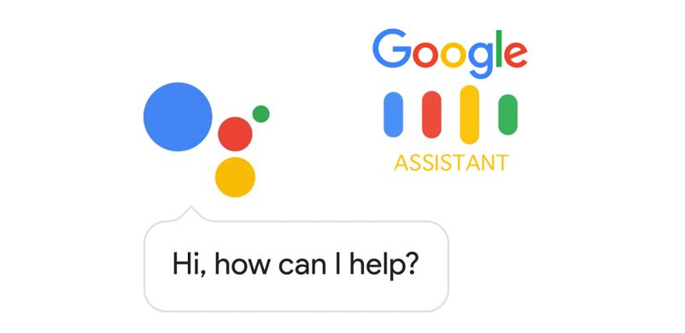
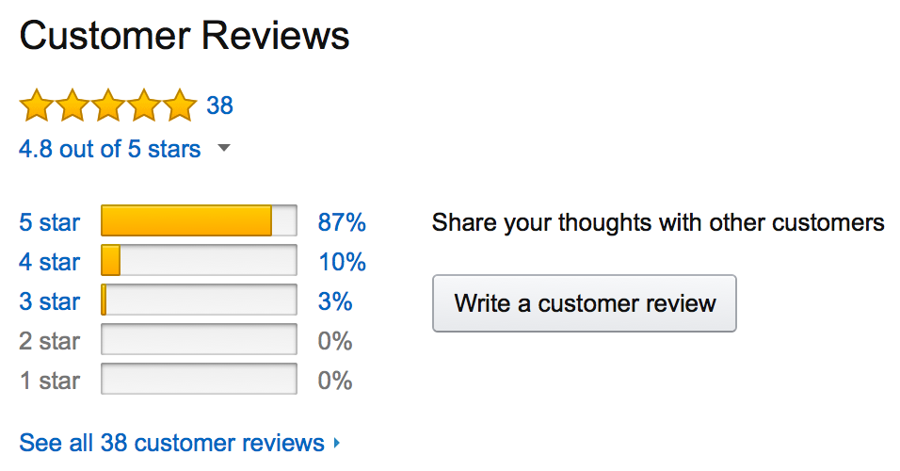
SENTIMENT ANALYSIS IN THE WORLD
The Obama administration used sentiment analysis to gauge public opinion to policy announcements and campaign messages ahead of 2012 presidential election. Being able to quickly see the sentiment behind everything from forum posts to news articles means being better able to strategise and plan for the future.

Slide 27
OUR FUTURE GOALS
1.TO FETCH THE DATA IN DESIRED FORMAT
2.TO TOKENIZE THE DATA WITH DIFFERENT METHODS
3.TO EXTRACT FEATURES
4.IMPROVEMENT OF THE ALGORITHM
5.TO PREDICT DIFFERENT RESULTS USING THIS PROJECT

Slide 28

THANK YOU

